Slide 1
Overfitting and hyperparameter search

Slide 2
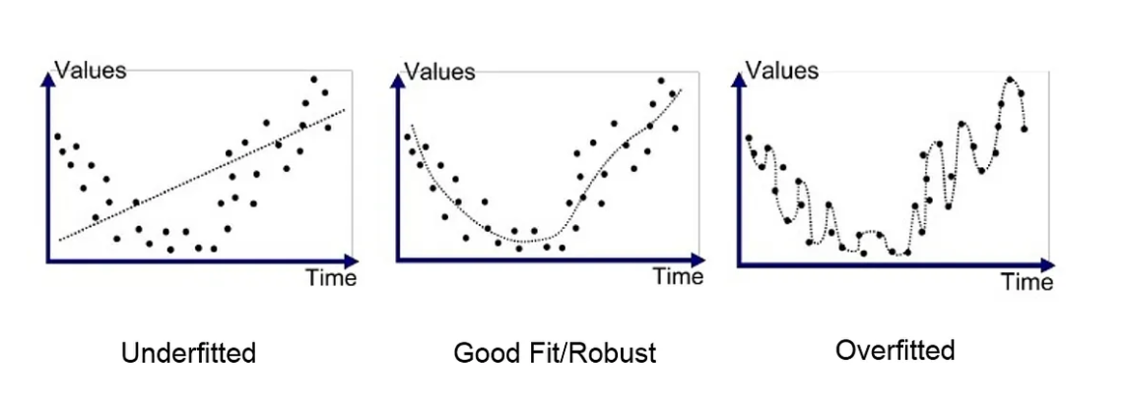
Avoiding overfitting

Slide 3
Hyperparameters
Learning Rate
Batch Size
Number of Epochs
Number of Layers
Number of Neurons per Layer

Slide 4
Train, Validation, Test Split
Purpose: Ensures proper evaluation of machine learning models and prevents overfitting.
1. Training Set (70%-80%) of the total dataset.
Usage: Used to train the model by learning patterns in the data.
2. Validation Set (10%-15%) of the total dataset
Usage: Used to tune hyperparameters and make decisions about model architecture
3. Test Set (10% - 15%) of the total dataset
Usage: Used only once, after training and validation, to evaluate final model performance.

Slide 5
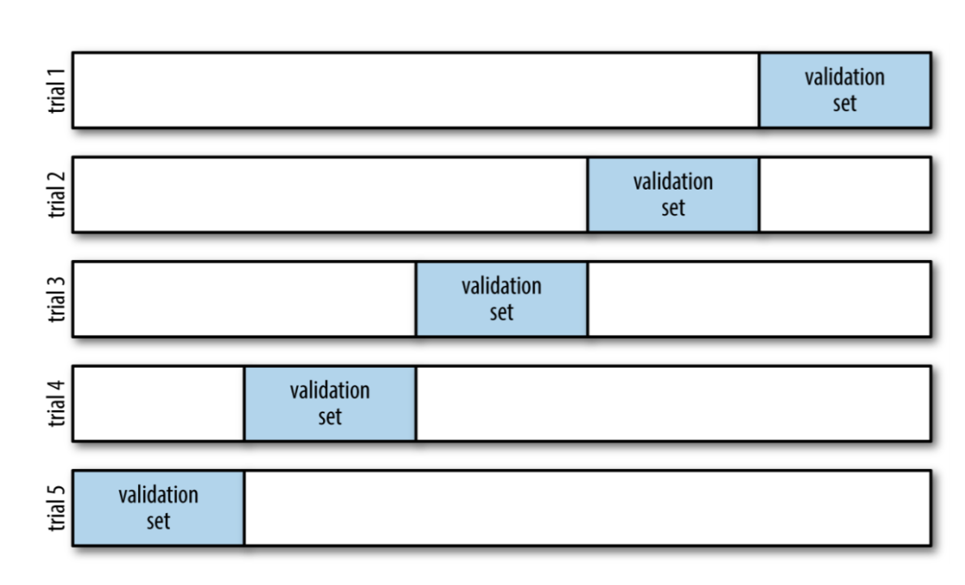
Cross Validation
Usage: Reduced Risk of Overfitting to a Particular Split

Slide 6
How to look for hyperparameter effectively?
There are mainly three main hyperparameter optimization algorithms that we are going to cover during this presentaiton:
Grid Search
Random Search
Bayesian Search

Slide 7
Grid Search
Define Parameter Ranges: Specify discrete values for each hyperparameter to form a grid of possible combinations.
Evaluate All Combinations: Train and validate the model for each combination of hyperparameters across cross-validation folds or simply validation set, recording performance metrics.
Select Best Parameters: Identify the hyperparameter combination that yields the best average performance across folds or validation set.

Slide 8
The main disadvantages of Grid Search
High Computational Cost: Evaluates all combinations, making it resource-intensive for large search spaces.
Inefficient in High Dimensions: Poor scalability, as adding more parameters exponentially increases combinations.
No Adaptability: Lacks focus on promising regions. Each run is independent.

Slide 9
Exponential Growth in Grid Search
Suppose we have 2 parameters, each with 5 possible values. Then we have 5*5 = 25 possible values.
For 3 parameters we have 5*5*5 = 125
For 5 parameters we have already 5*5*5*5 = 3125 (!)
This exponential growth quickly becomes computationally expensive!

Slide 10
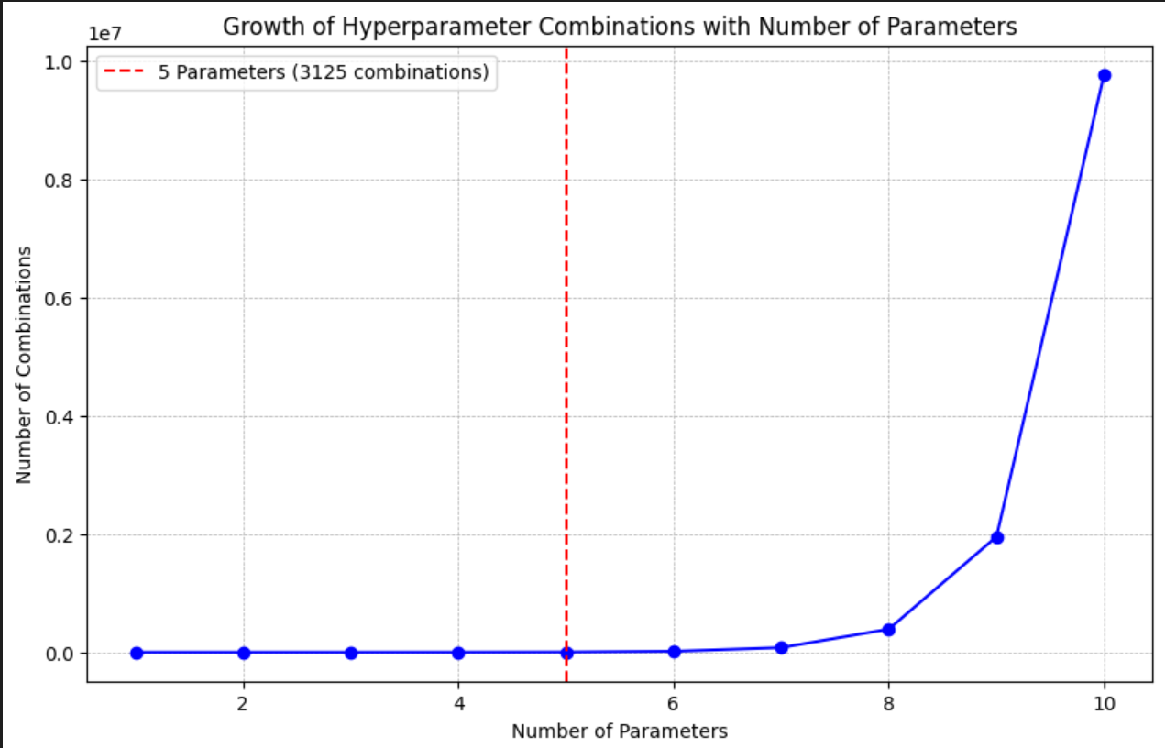

Slide 11
This is why optimization techniques are important
Imagine you want to look for a search space of 3125 combinations (which is just a 5 parameters of 5 possible values)
Imagine it takes a day to estimate a full model (which happens very often in deep learning).
Then going through all 3125 combinations would take 3125 days which is approx. 8.5 years!

Slide 12
Hyperparameter search in quickly estimated models.
When Models are Fast to Train: For simpler models like linear or logistic regression, each model evaluation can be done in seconds or minutes. This reduces the overall burden of hyperparameter tuning.
Grid Search Feasibility: With low-cost evaluations, grid search or other exhaustive methods are more practical, as you can afford to evaluate a larger portion of the parameter space without excessive time costs.

Slide 13
The answer to this problem – Random Search
Define Parameter Distributions: Set probability distributions or ranges for each hyperparameter, allowing for random sampling within the specified range.
Sample and Evaluate Random Combinations: Randomly sample a specified number of hyperparameter combinations, then train and validate the model for each, recording performance metrics.
Select Best Parameters: Identify the hyperparameter combination with the highest performance based on validation results, focusing on the most promising sampled configurations.

Slide 14
Still some problems…
Inefficient Resource Use: Random search allocates the same amount of resources (e.g., training time) to each sampled configuration, even if some configurations show poor performance early on.
High Computational Cost: For complex models, evaluating many random configurations can still be expensive and time-consuming without a focus on promising candidates.
No Adaptability: Lacks focus on promising regions. Each run is independent. (just like in grid search)

Slide 15
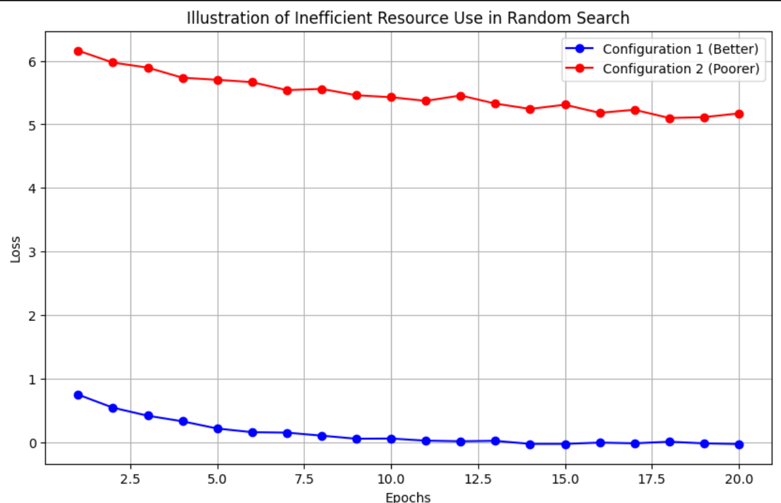
Random search allocates equal training time to both models, even though the red model performs significantly worse than the blue model

Slide 16
The answer to this problem – Succesive halving
1. Initialization
Generate a set of hyperparameter configurations (typically chosen randomly).
Set an initial, small budget for each configuration (e.g. numer of samples, training time etc.)
2. For Each Round:
Evaluate Configurations
Train each configuration in the current set with the allocated budget.
Record performance for each configuration.
Select Top Performers
Rank configurations based on their performance.
Keep only the top-performing configurations for the next round.
Increase Budget
Double or increase the budget for the remaining configurations.
3. Termination
Repeat until only one configuration remains or the maximum budget is reached.
Return the best-performing configuration as the final result.

Slide 17
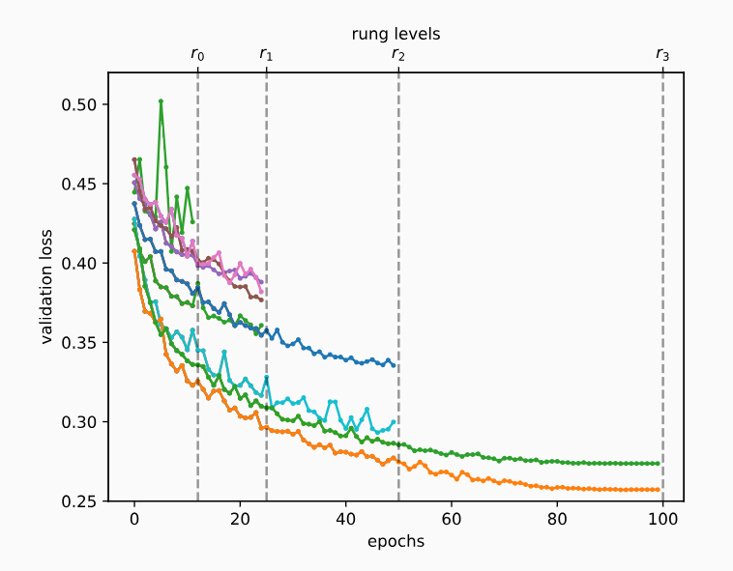
Succesive halving
Source: https://d2l.ai/chapter_hyperparameter-optimization/sh-intro.html

Slide 18
Still we have one problem…
No Adaptability: Lacks Focus on Promising Regions
To illustrate the issue with random search:
Objective: Optimize a single hyperparameter where lower values are better.
Problem Setup:
Best performance (0.1) occurs at hyperparameter value 50.
Hyperparameter search space: {1, …, 100}.
Random Search Challenge:
Randomly sampled values don’t focus on the promising region, even after finding good values.

Slide 19
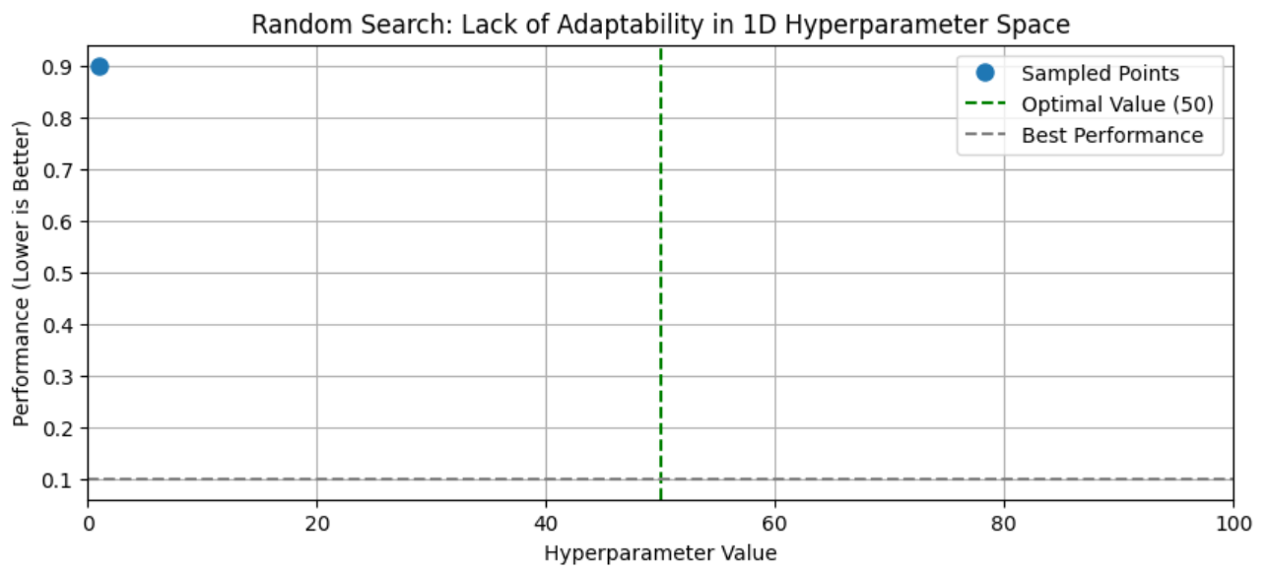
First Sample: Hyperparameter = 1, Poor Performance

Slide 20
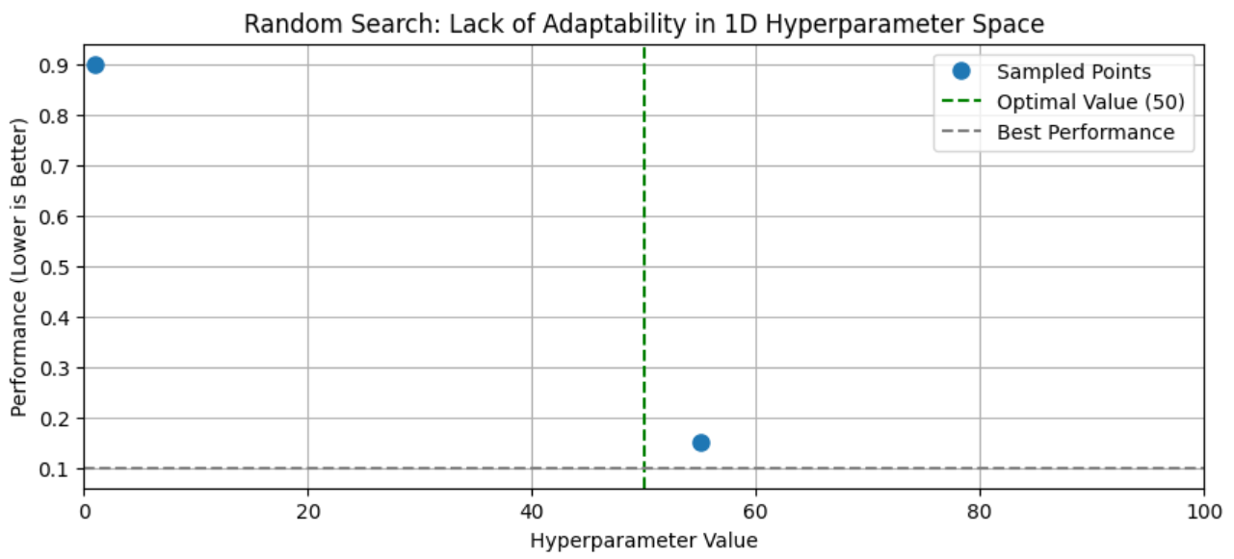
Second Sample: Hyperparameter = 55, Very good performance

Slide 21
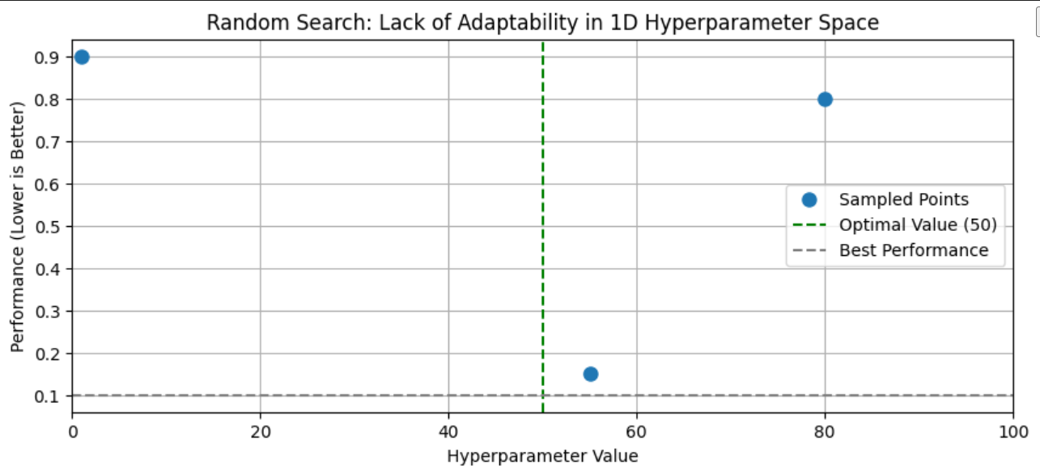
Third Sample: Hyperparameter = 80, again poor performance.

Slide 22
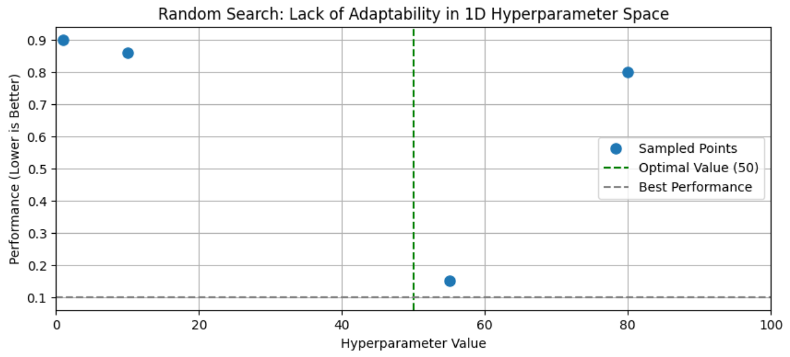
Fourth Sample: Hyperparameter = 10, again poor performance

Slide 23
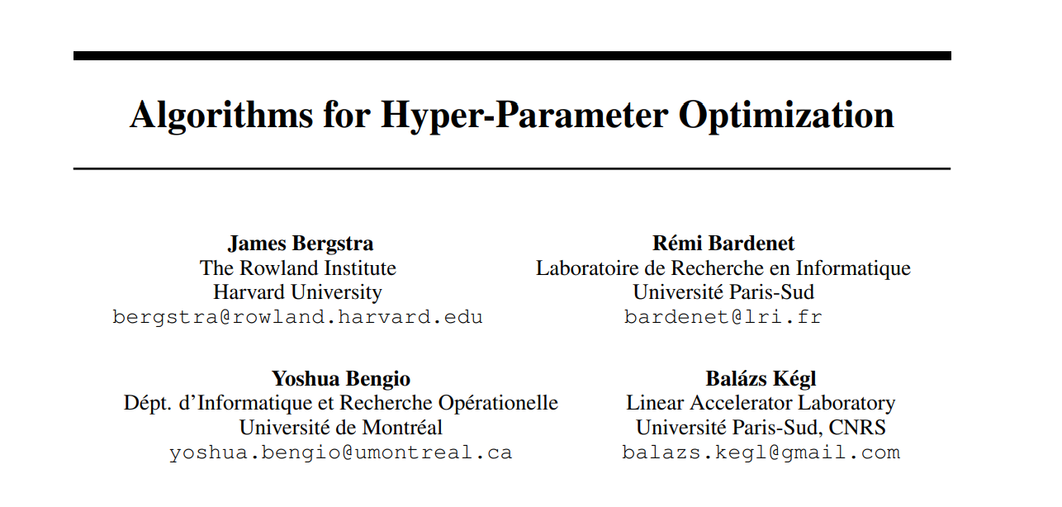
The answer to this problem – Bayesian Hyperparameter search

Slide 24
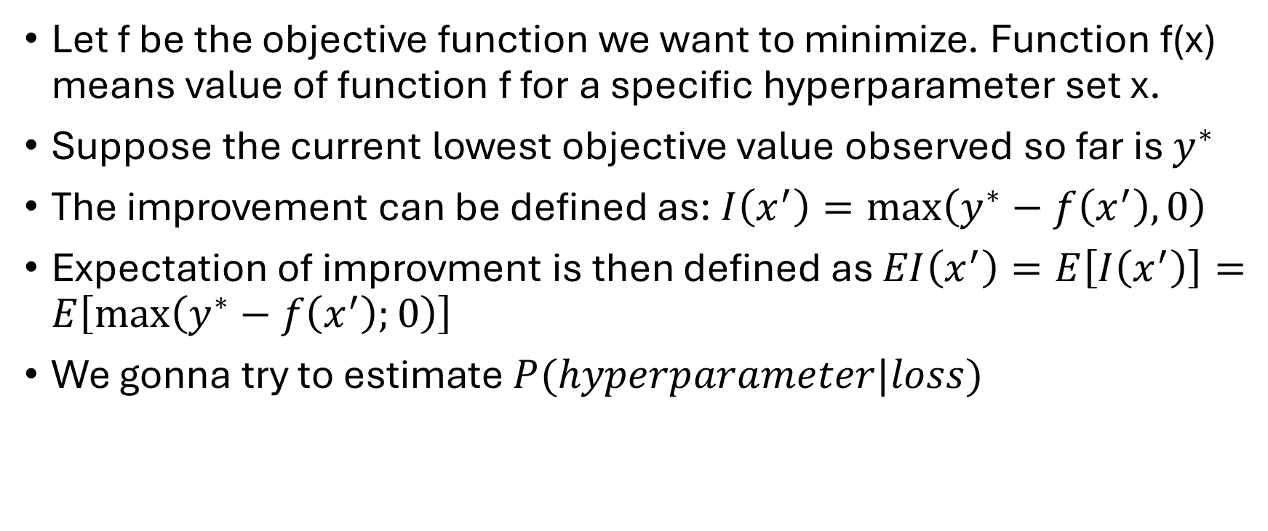
Tree Parzen Estimator
Let f be the objective function we want to minimize. Function f(x) means value of function f for a specific hyperparameter set x.
Suppose the current lowest objective value observed so far is $y^{∗}$
The improvement can be defined as: $I\left(x^{′}\right)=\max\left(y^{∗}−f\left(x^{′}\right),0\right)$
Expectation of improvment is then defined as $EI\left(x^{′}\right)=E\left[I\left(x^{′}\right)\right]=E\left[\max\left(y^{∗}−f\left(x^{′}\right);0\right)\right]$
We gonna try to estimate $P(hyperparameter|loss)$

Slide 25
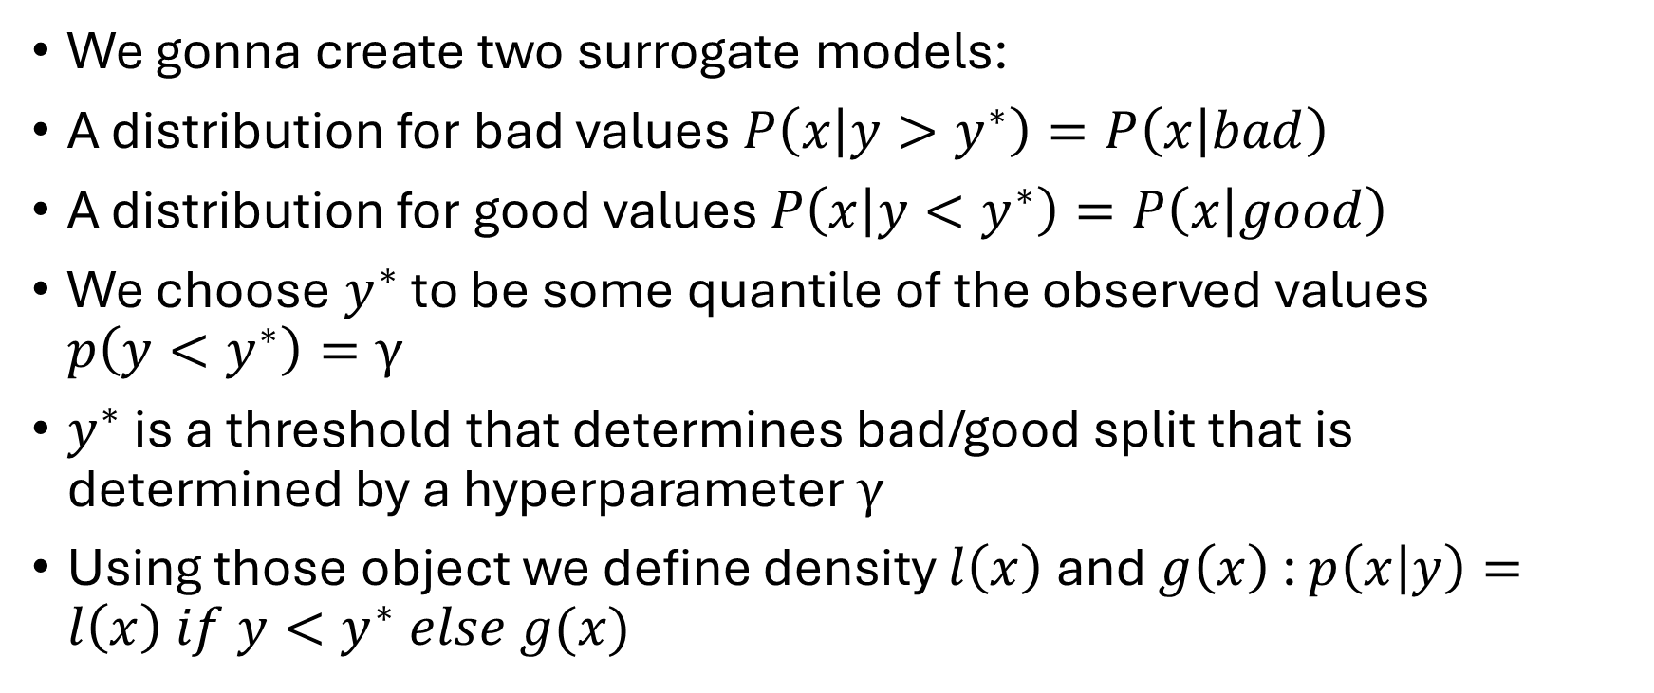
Tree Parzen Estimator
We gonna create two surrogate models:
A distribution for bad values $P\left(x | y>y^{∗}\right)=P\left(x | bad\right)$
A distribution for good values $P\left(x | y<y^{∗}\right)=P\left(x | good\right)$
We choose $y^{∗}$ to be some quantile of the observed values $p\left(y<y^{∗}\right)=γ$
$y^{∗}$ is a threshold that determines bad/good split that is determined by a hyperparameter $γ$
Using those object we define density $l\left(x\right)$ and $g\left(x\right)$ : $p\left(x | y\right)=l\left(x\right) if y<y^{∗} else g(x)$

Slide 26

Main contribution
In this paper they proved that: $EI(x)∝l(x)/g(x)$
This last expression shows that to maximize improvement we would like points x with high probability under $l(x)$ and low probability under $g(x)$.

Slide 27

Full algorithm – step 1
Define the search space for hyperparameters.
Set the $γ$ parameter, which determines the quantile threshold to split the configurations into "good" and "bad" groups.

Slide 28
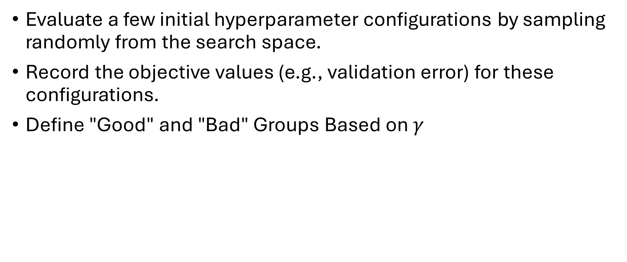
Full algorithm – step 2
Evaluate a few initial hyperparameter configurations by sampling randomly from the search space.
Record the objective values (e.g., validation error) for these configurations.
Define "Good" and "Bad" Groups Based on $γ$

Slide 29

Full algorithm – step 3
Estimate Probability Densities $l\left(x\right)$ and $g(x)$:
$l\left(x\right)$ - density of a good group
g(x) – density of a bad group
Both of those distributions are estimated independently.

Slide 30
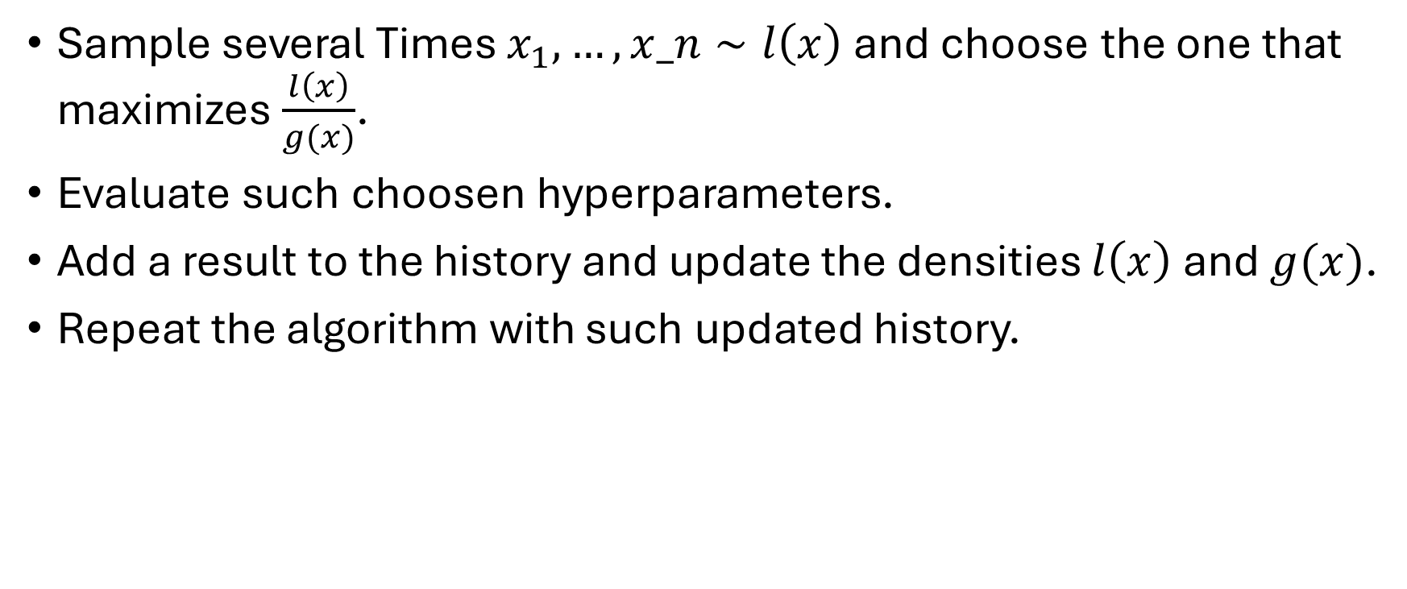
Full algorithm – step 4
Sample several Times $x_{1},…,x_n∼l\left(x\right)$ and choose the one that maximizes $\frac{l\left(x\right)}{g(x)}$.
Evaluate such choosen hyperparameters.
Add a result to the history and update the densities $l\left(x\right)$ and $g(x)$.
Repeat the algorithm with such updated history.

Slide 31
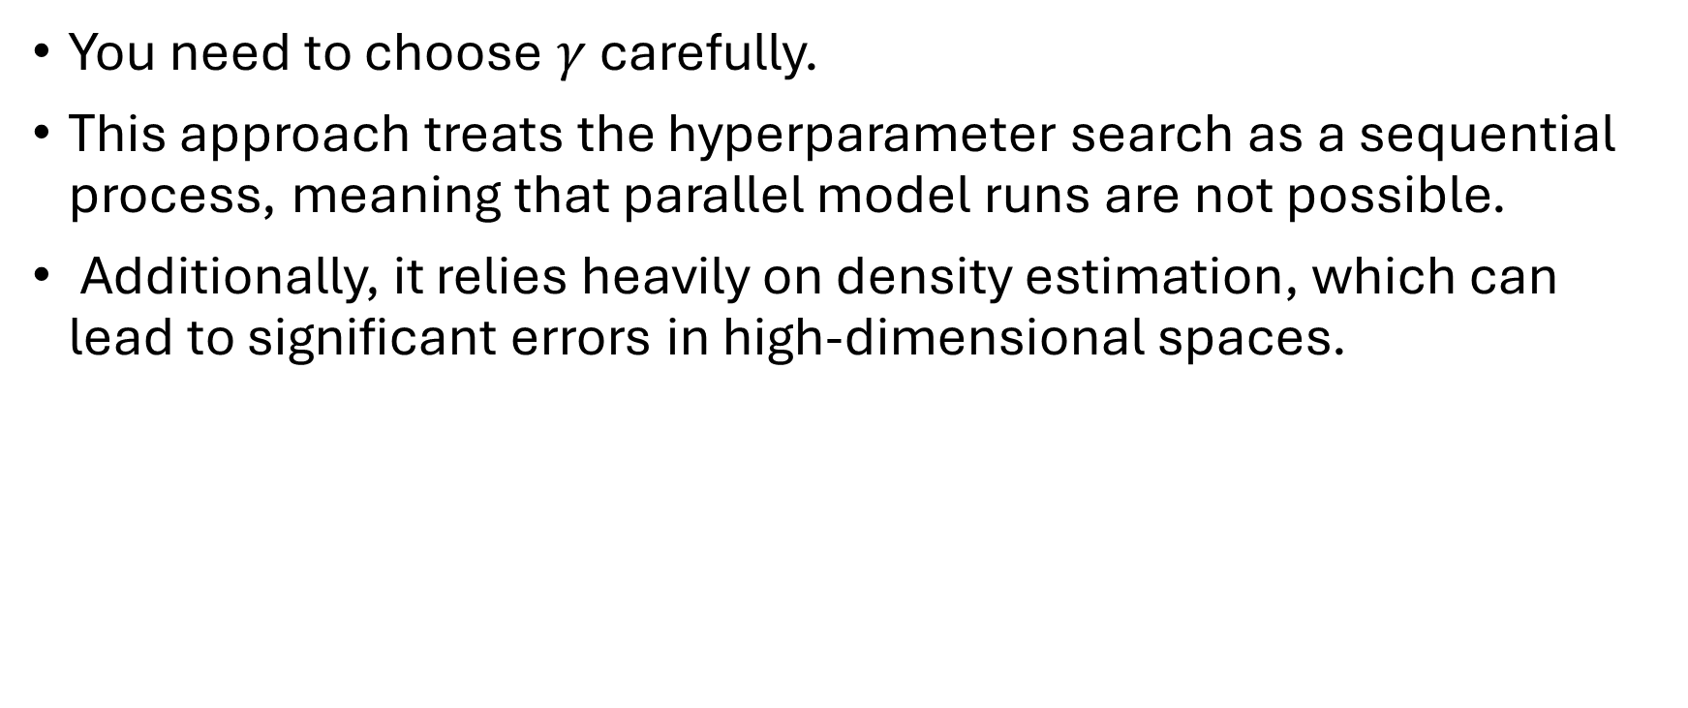
The main disadvantages of TPE algorithm
You need to choose $γ$ carefully.
This approach treats the hyperparameter search as a sequential process, meaning that parallel model runs are not possible.
Additionally, it relies heavily on density estimation, which can lead to significant errors in high-dimensional spaces.

Slide 32
Thank you for attention!

